Slide 1
Generalization, Regularization, Overfitting , validation
Victor Laverenko, Andrew NG, Yaser Abu Mustafa

Slide 2
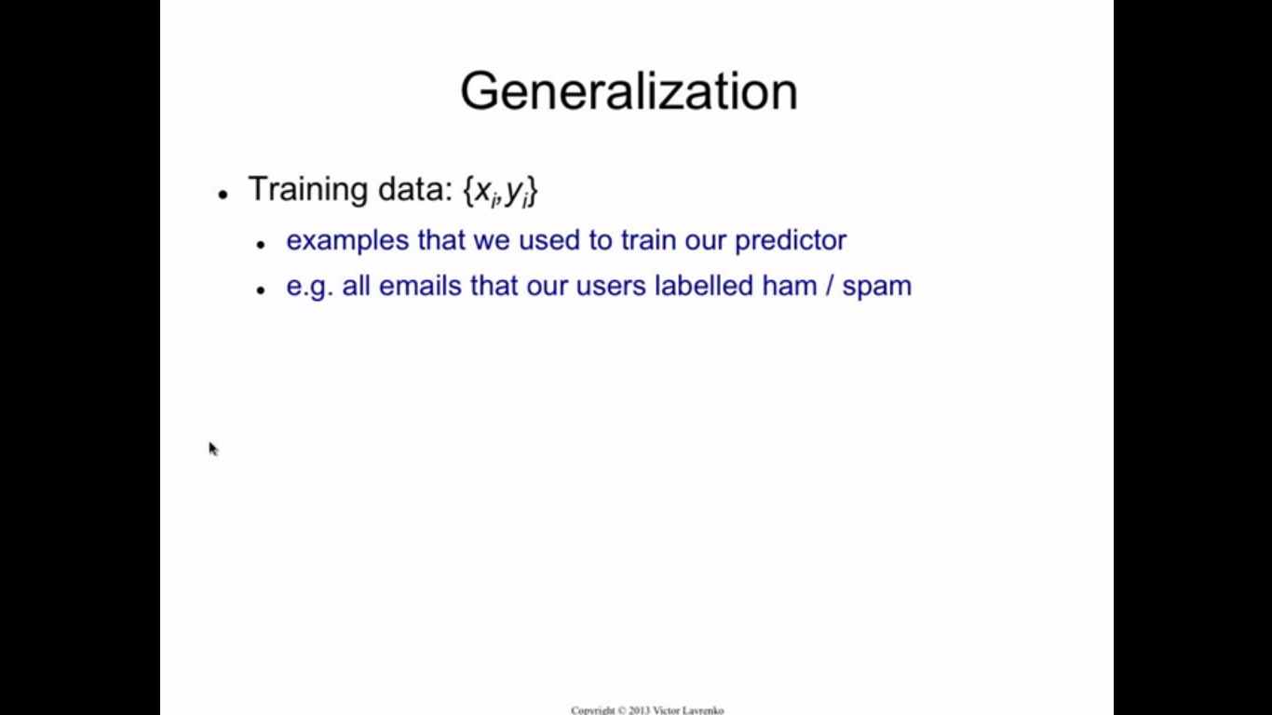

Slide 3
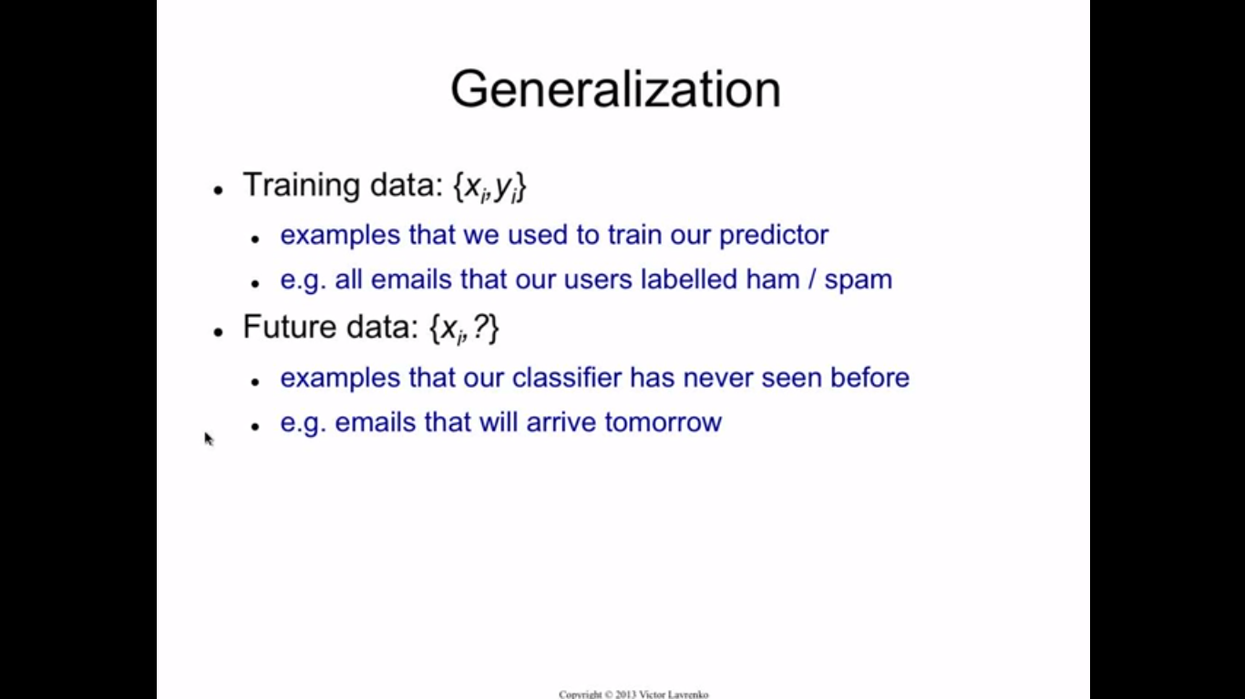

Slide 4
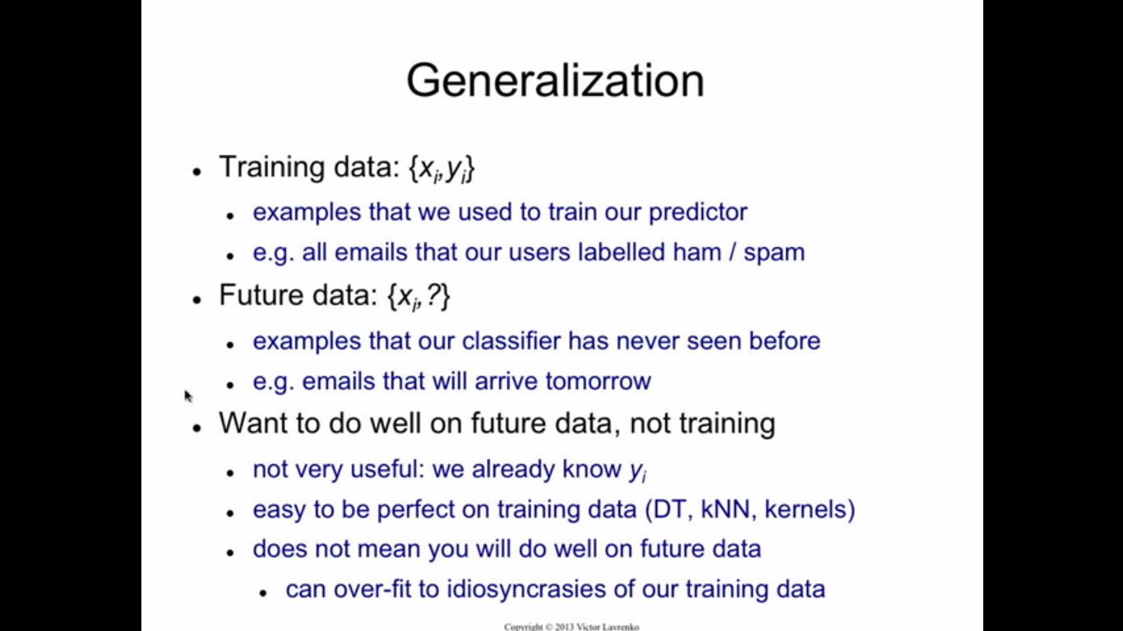

Slide 5
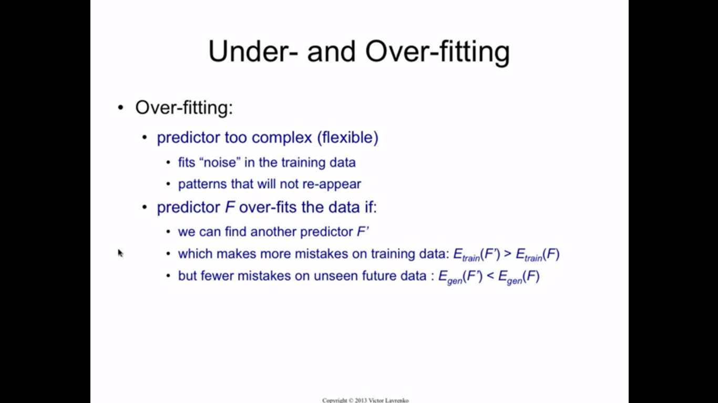

Slide 6
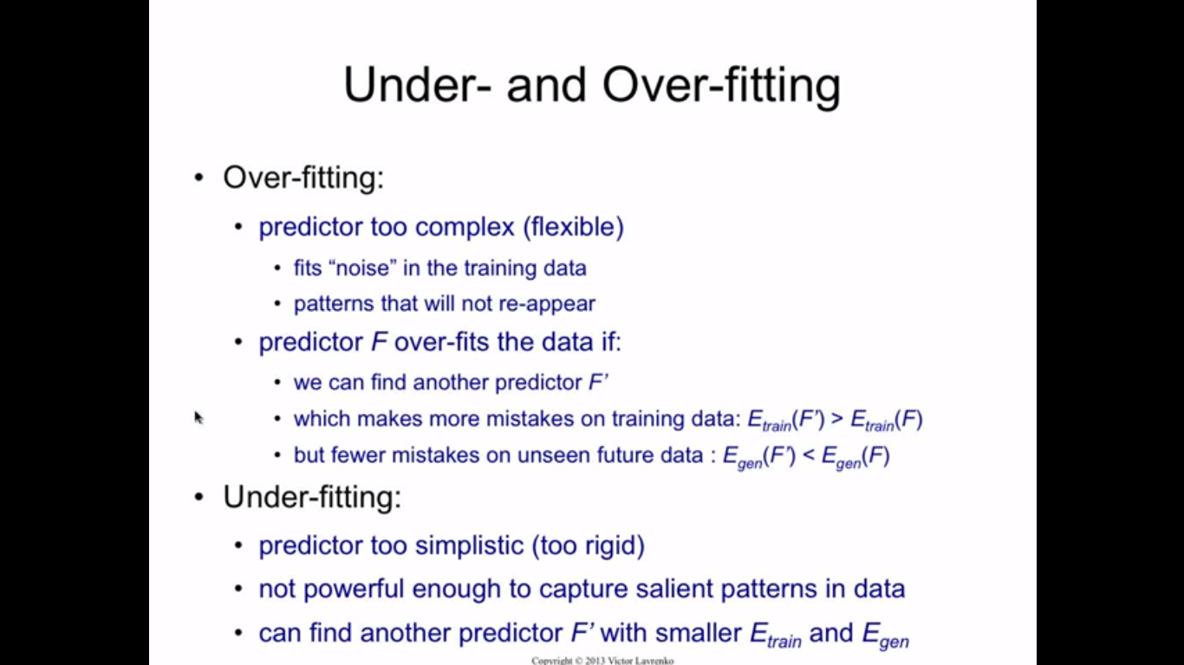

Slide 7
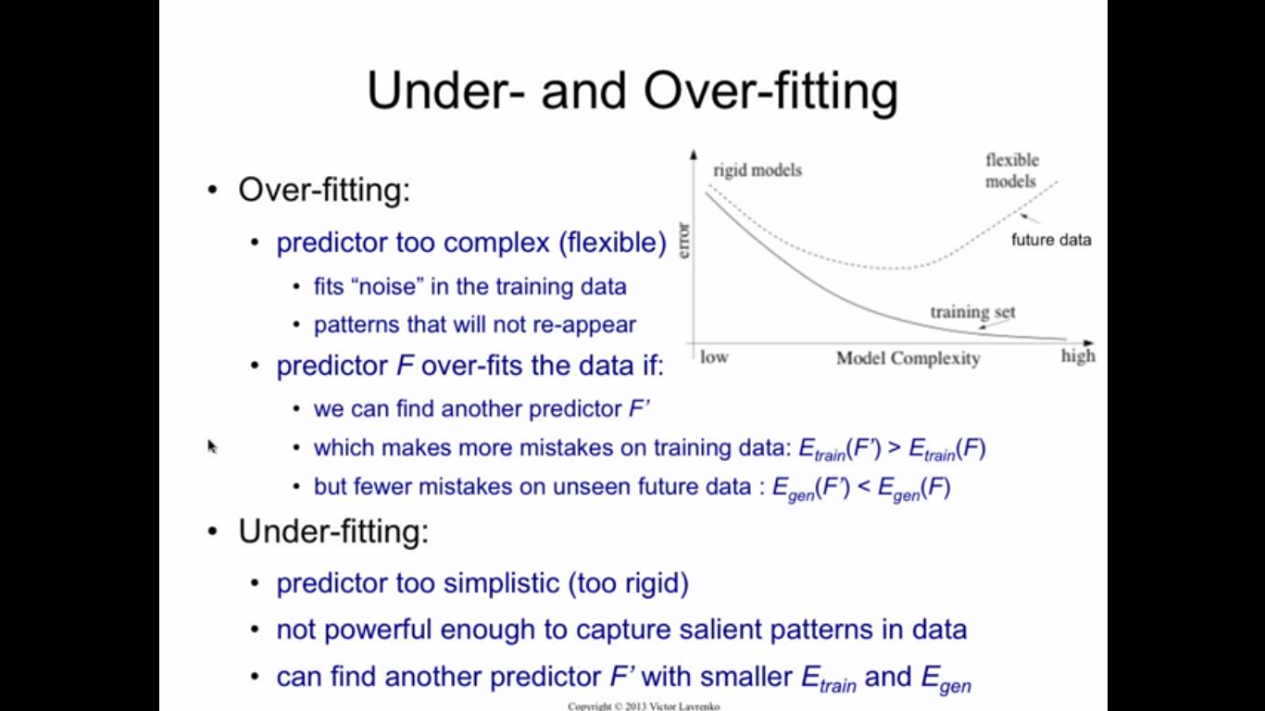

Slide 8
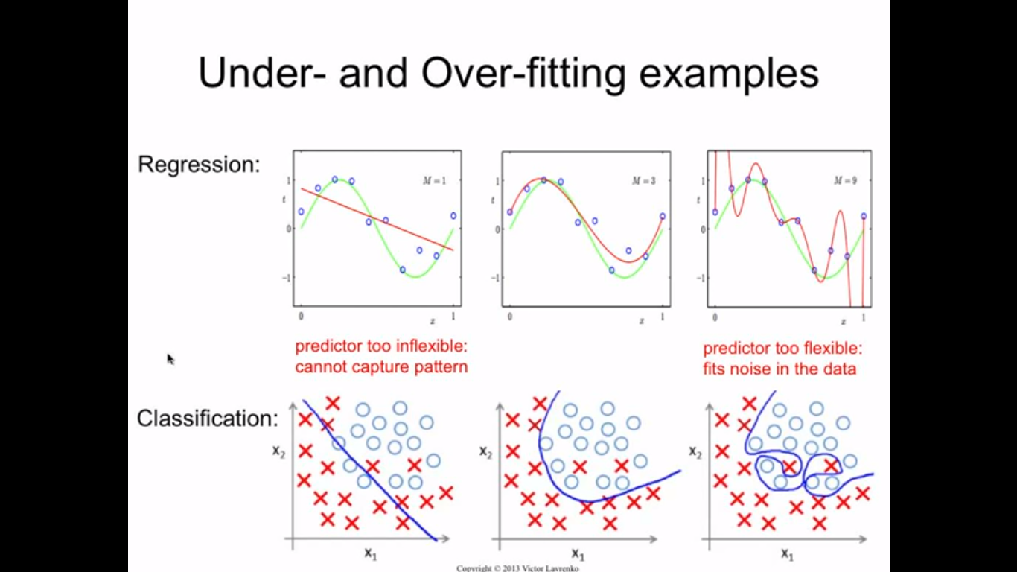

Slide 9
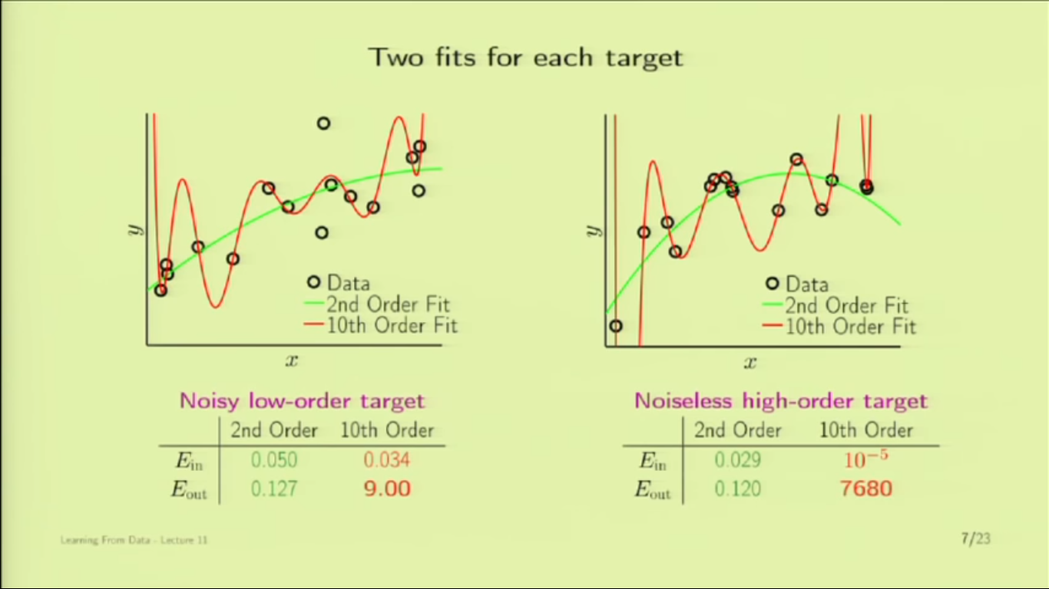

Slide 10
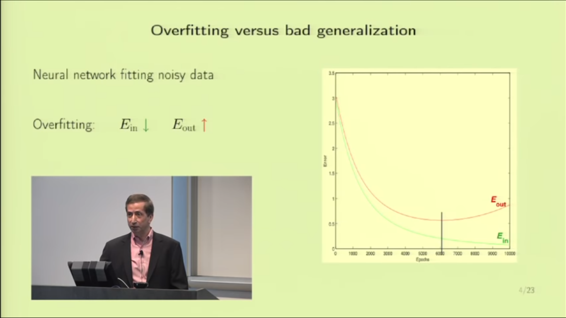

Slide 11
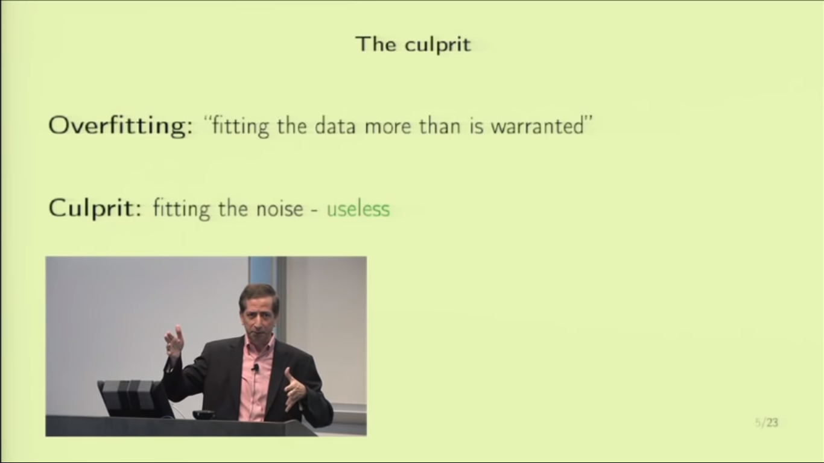

Slide 12
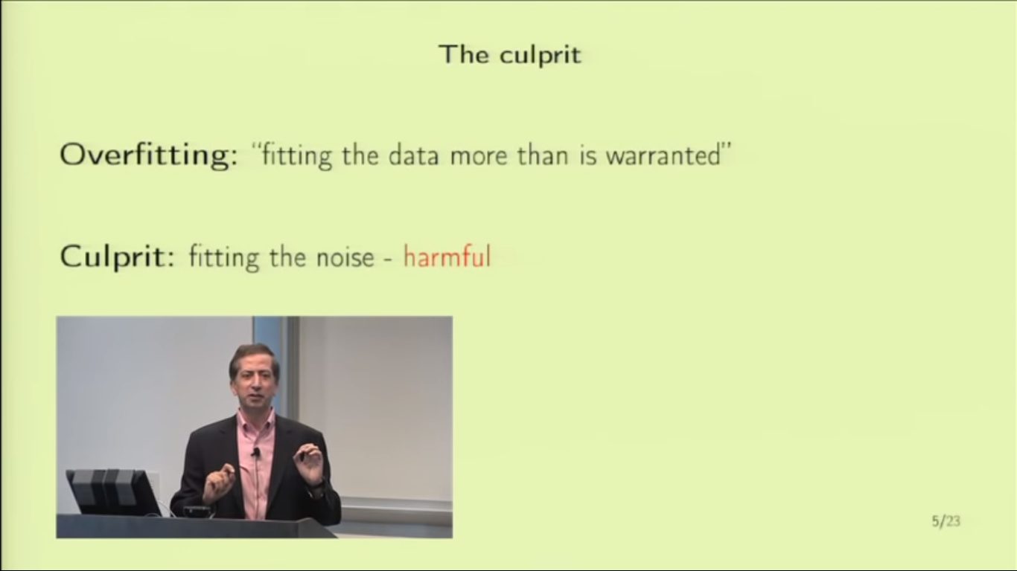

Slide 13
Solution to Overfitting
Reduce the number of feature
Model Selection
Regularization
Validation
We ll cover Regularization and Validation

Slide 14
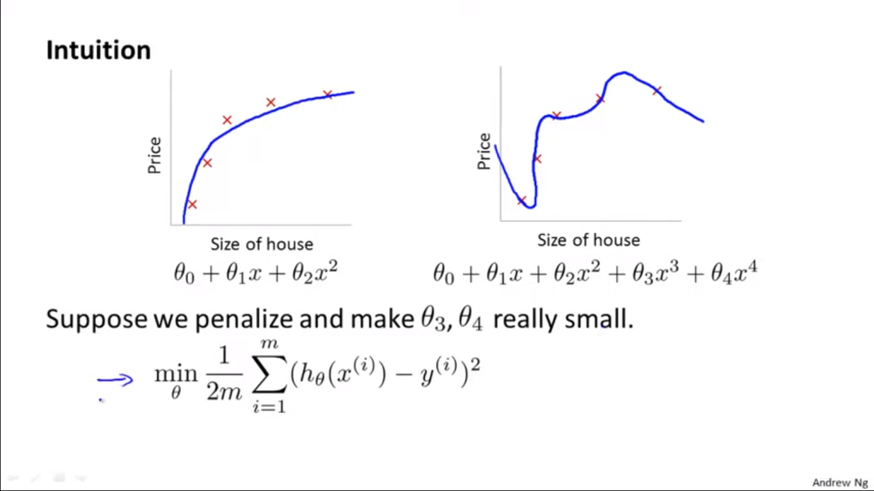

Slide 15
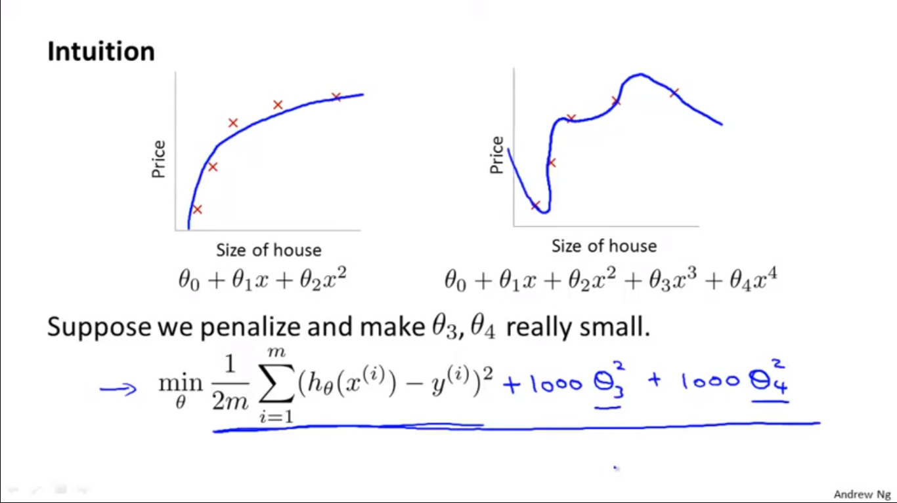

Slide 16
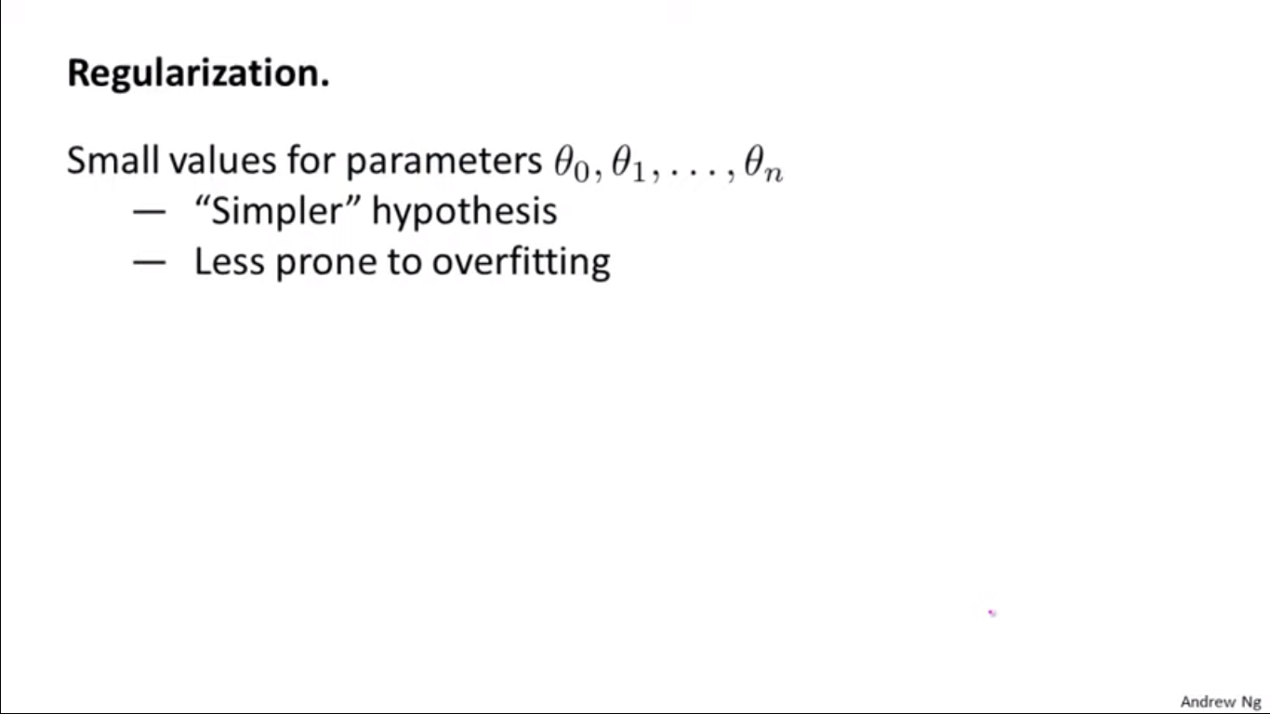

Slide 17
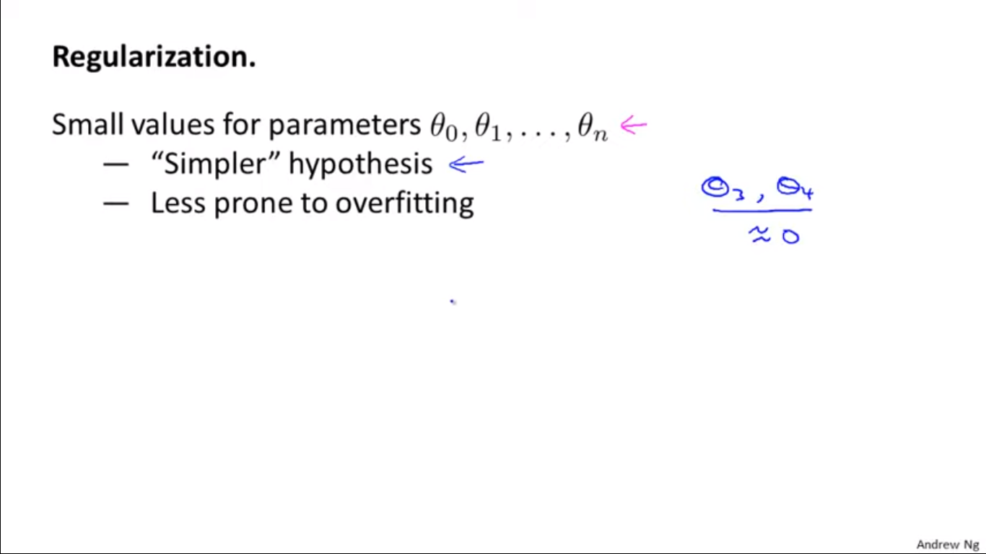

Slide 18
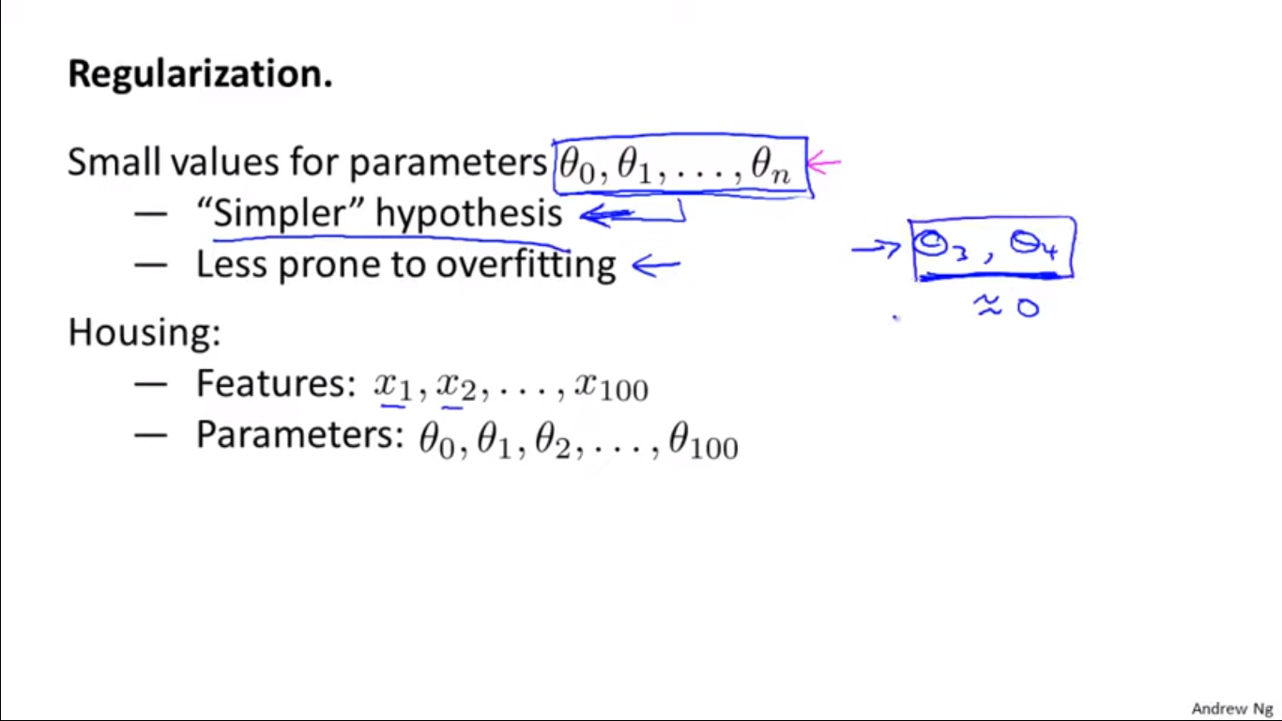

Slide 19
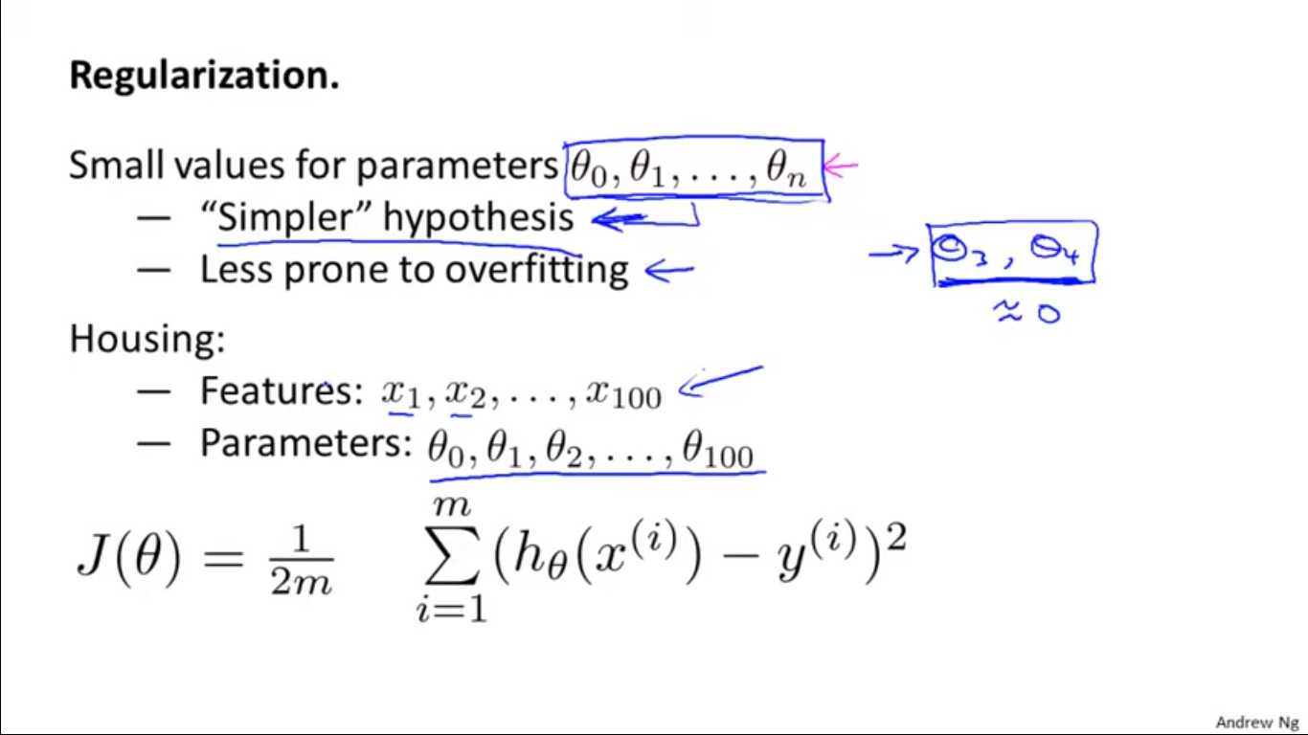

Slide 20
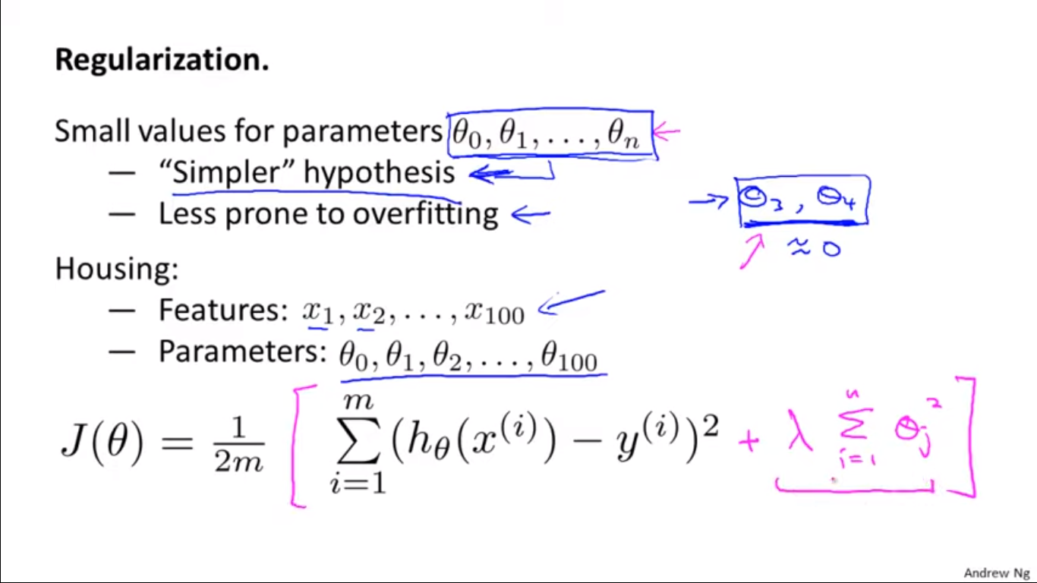

Slide 21
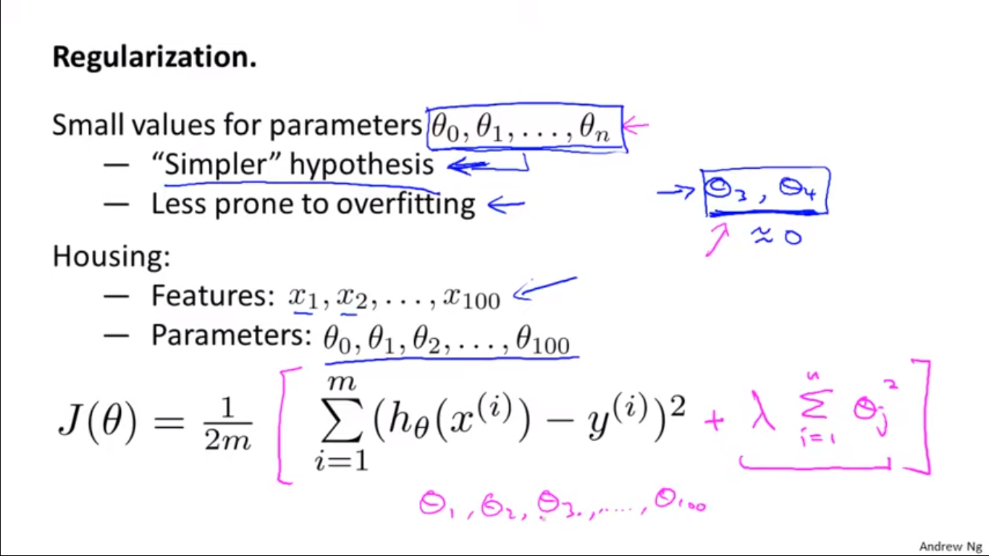

Slide 22
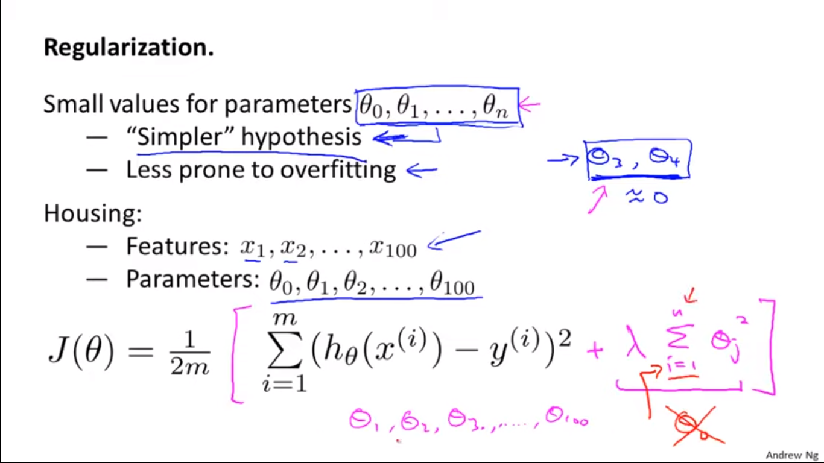

Slide 23
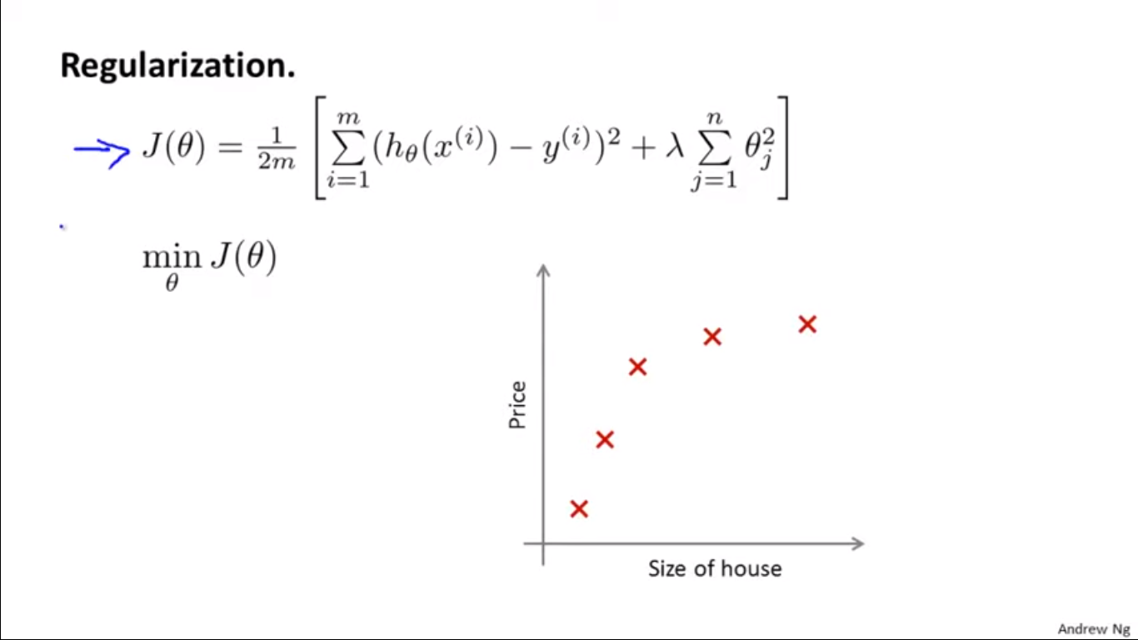

Slide 24
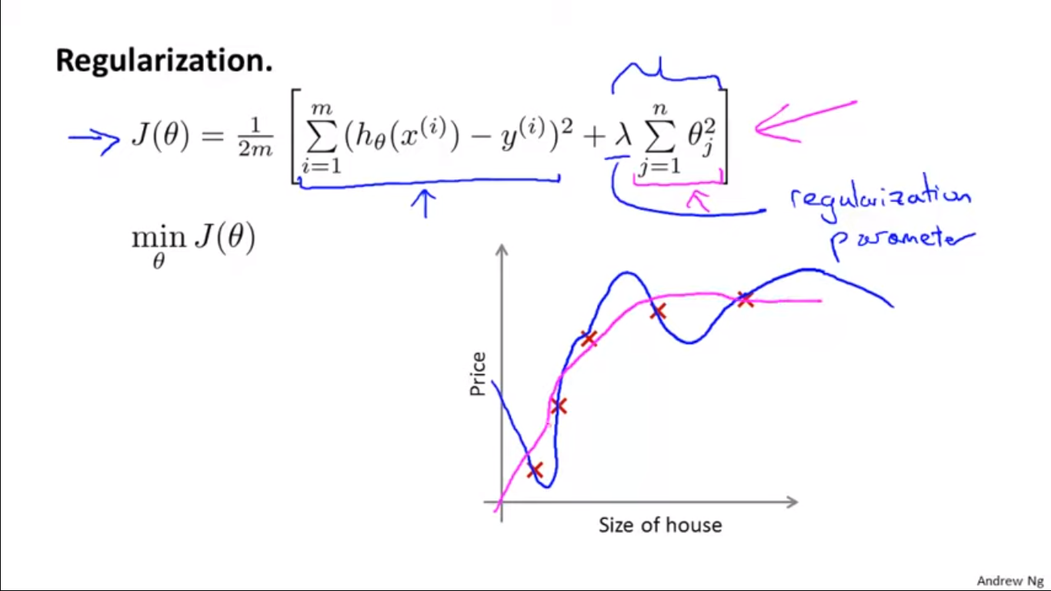

Slide 25
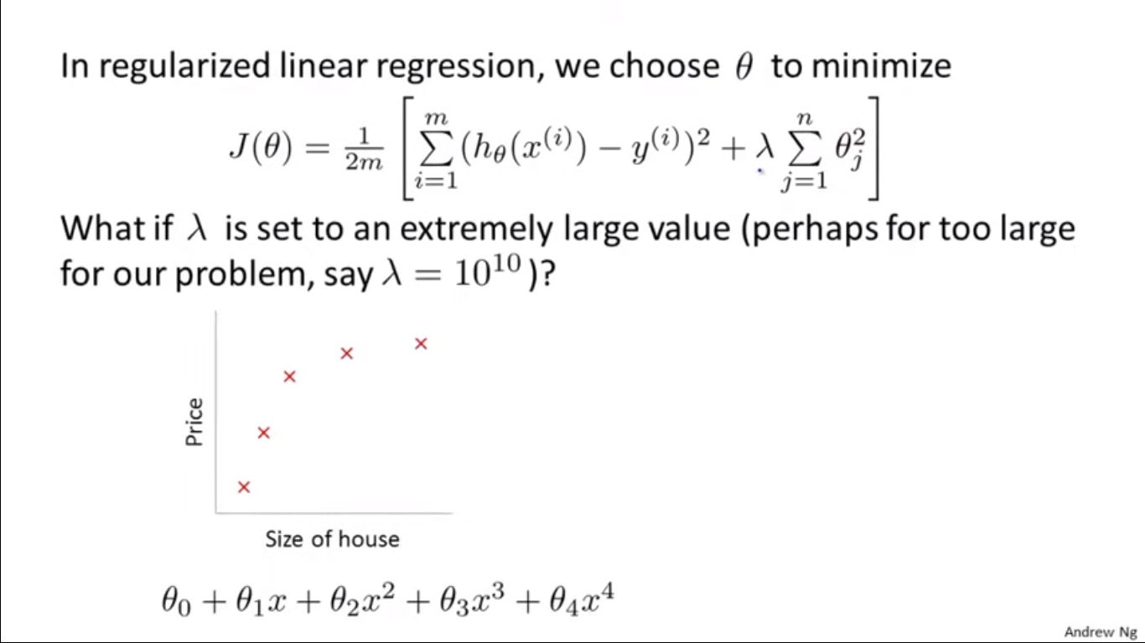

Slide 26
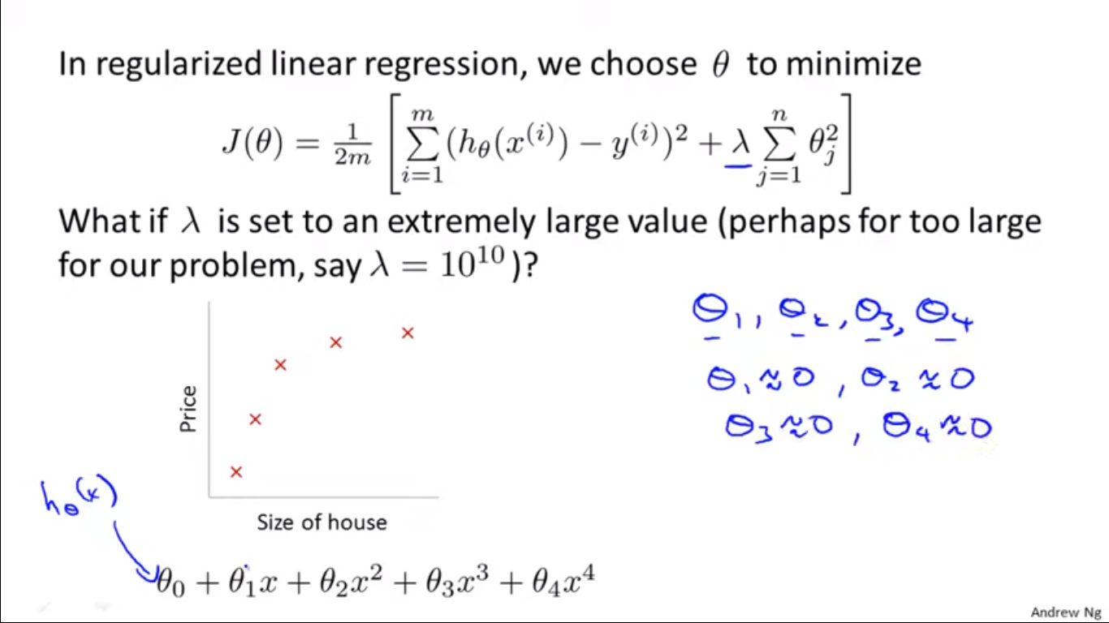

Slide 27
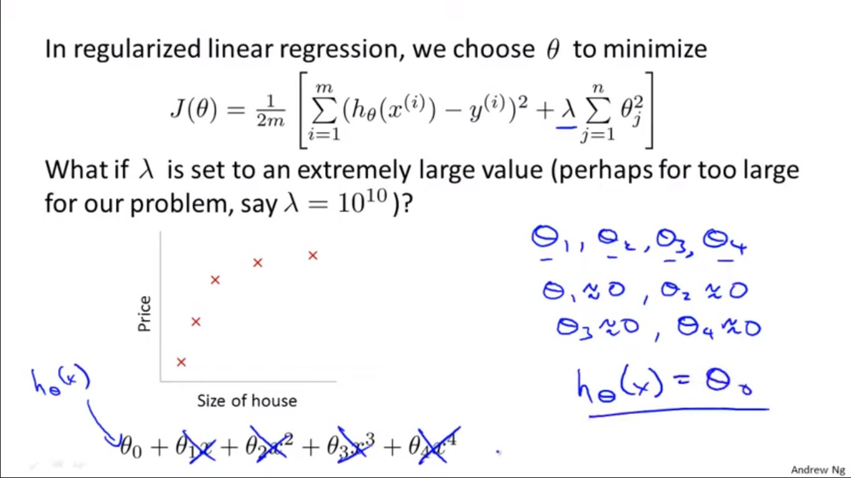

Slide 28
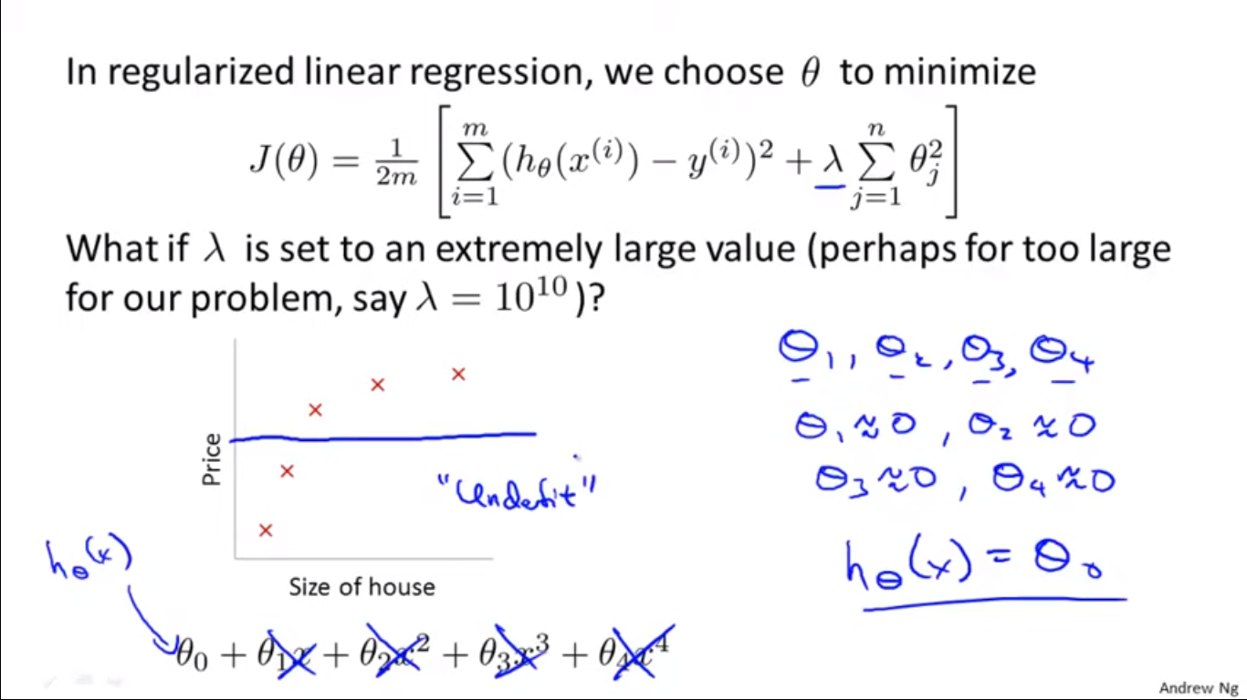

Slide 29
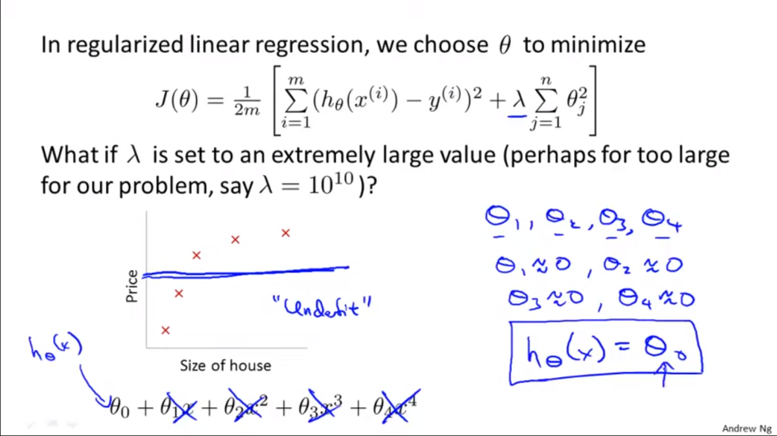

Slide 30
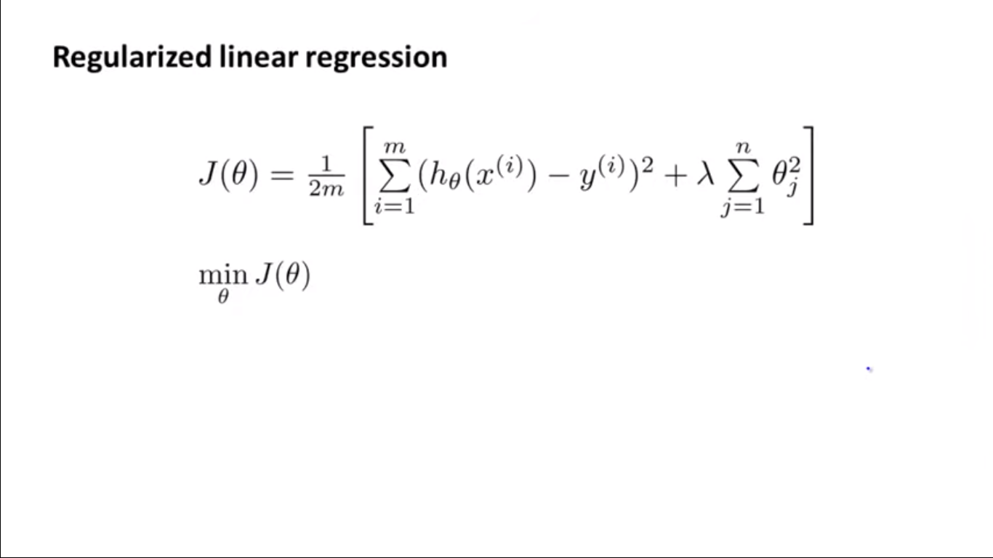

Slide 31
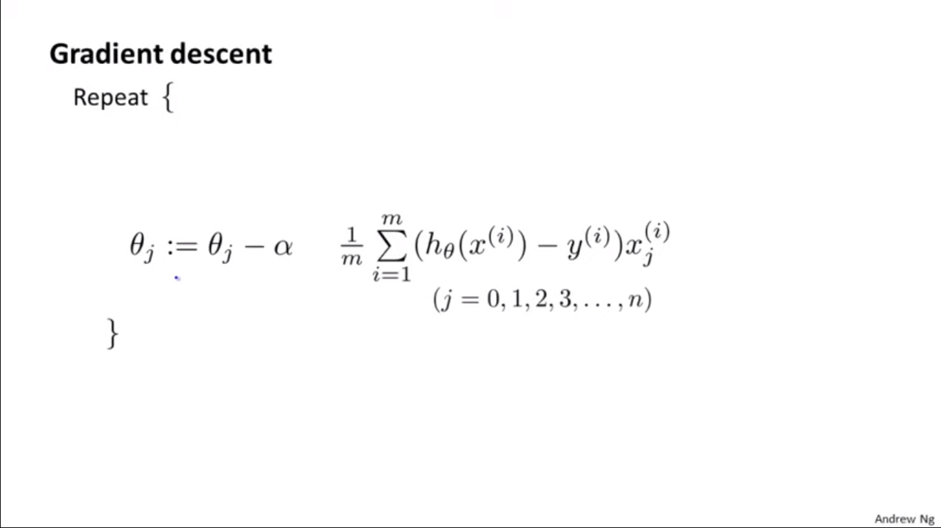

Slide 32
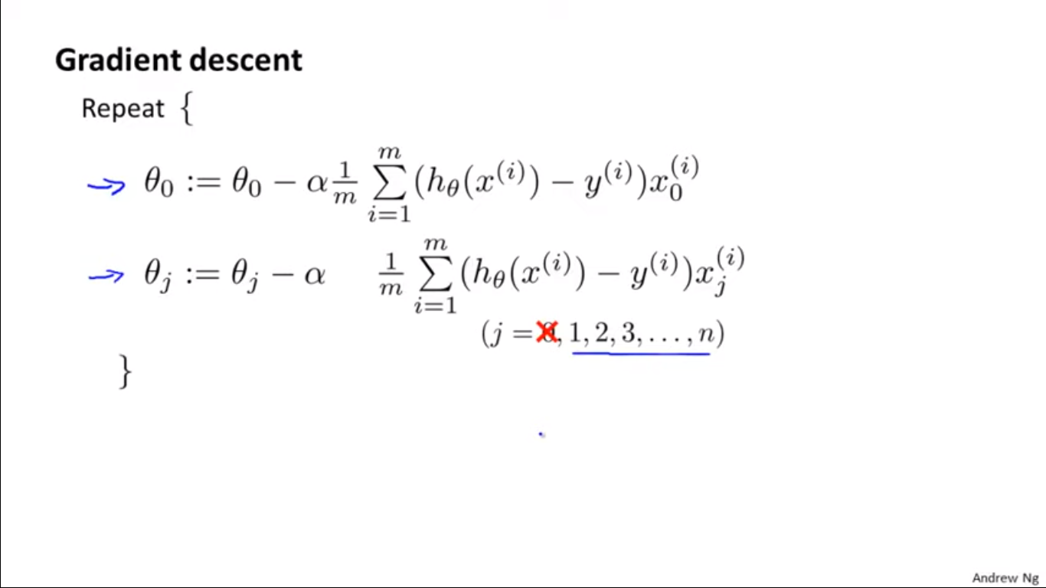

Slide 33
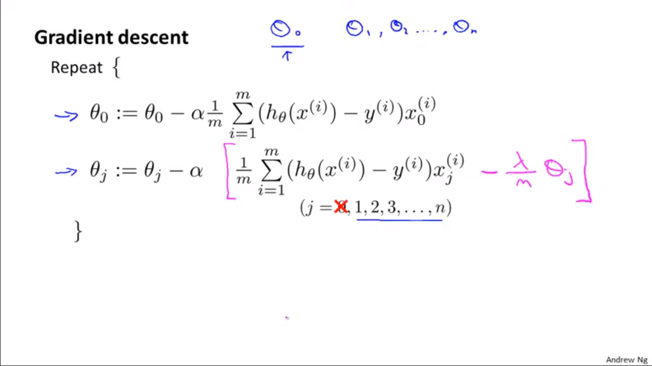

Slide 34
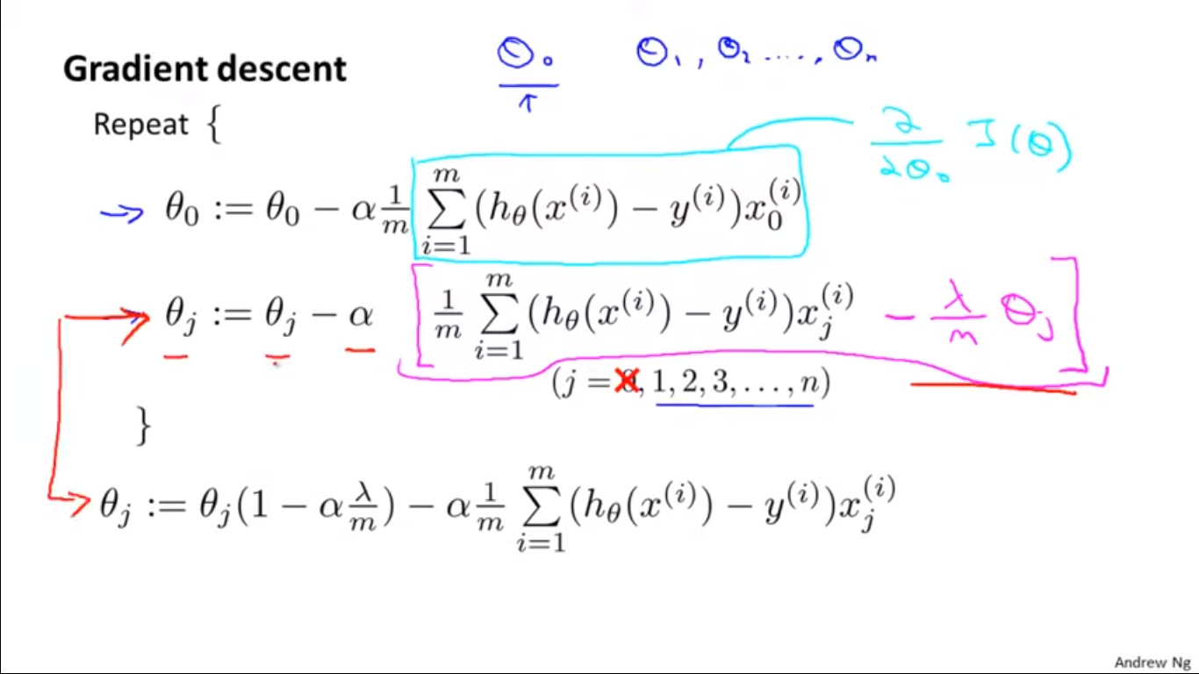

Slide 35
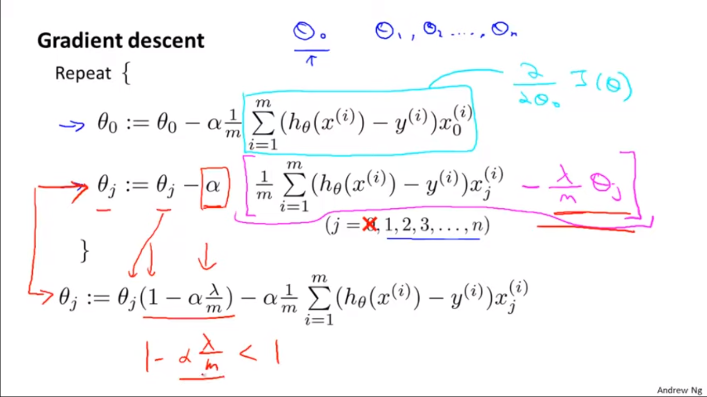

Slide 36
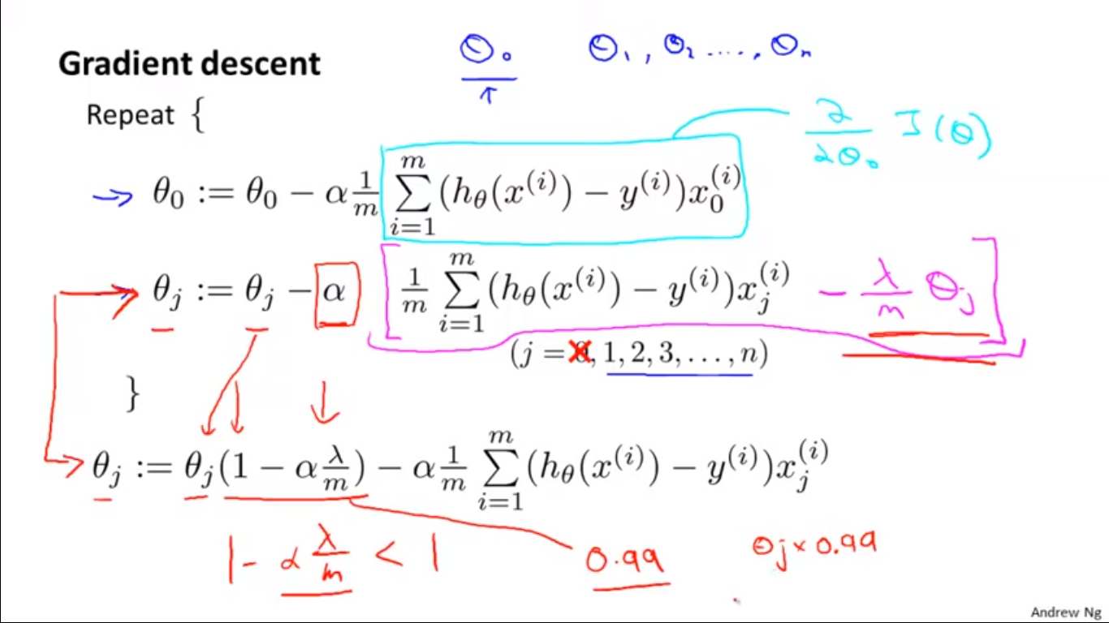

Slide 37
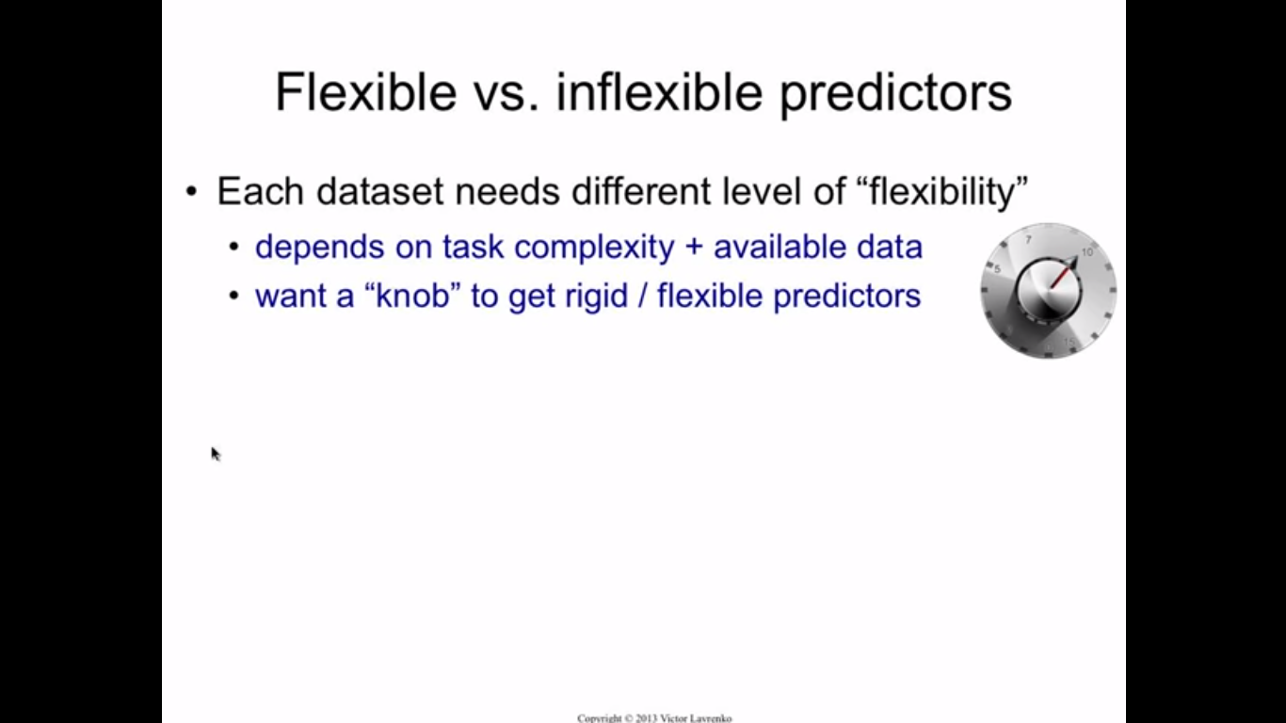

Slide 38
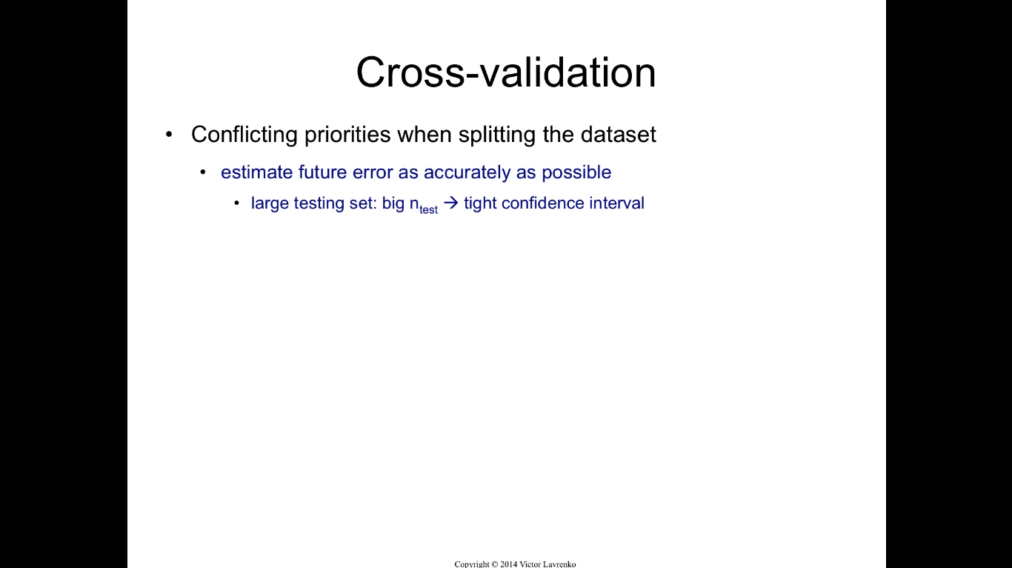

Slide 39
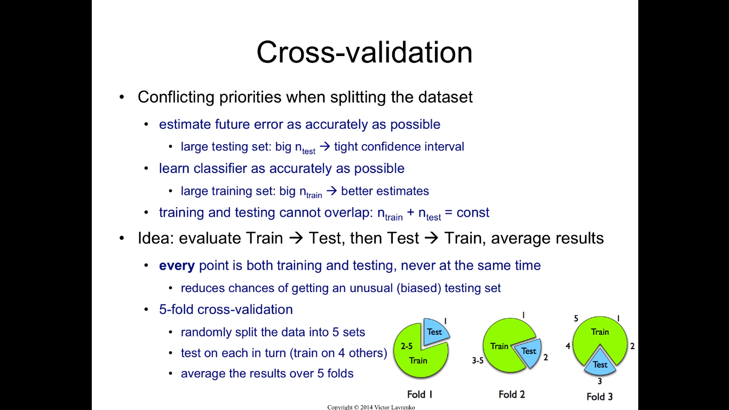

Slide 40
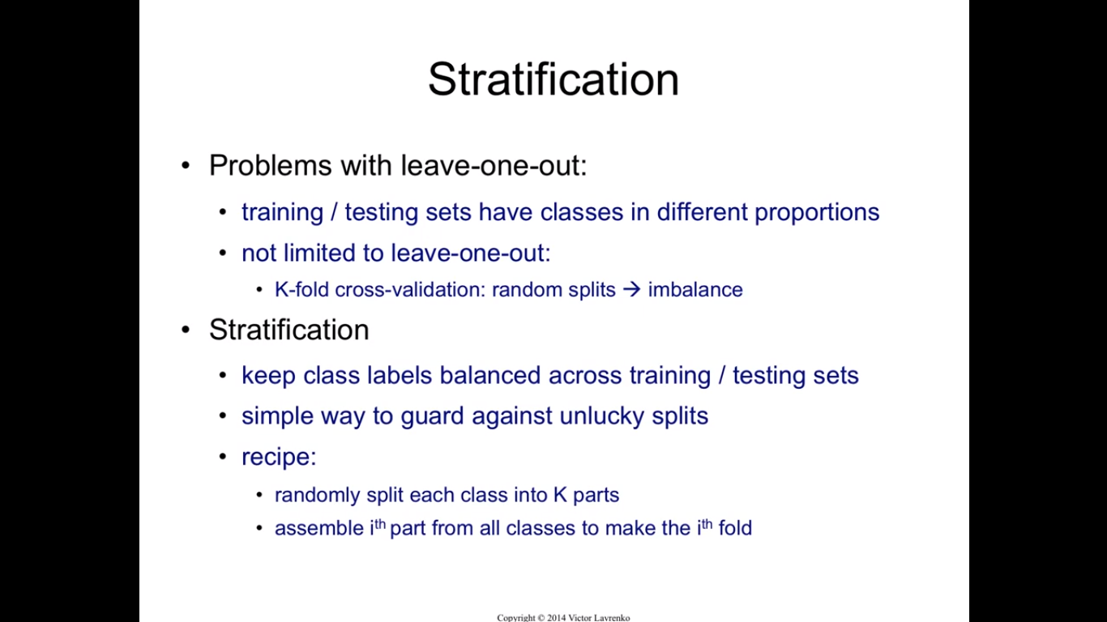

Slide 41
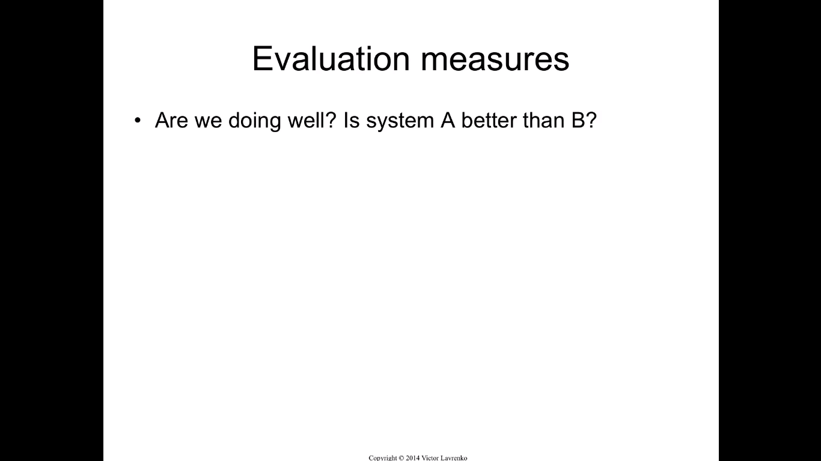

Slide 42
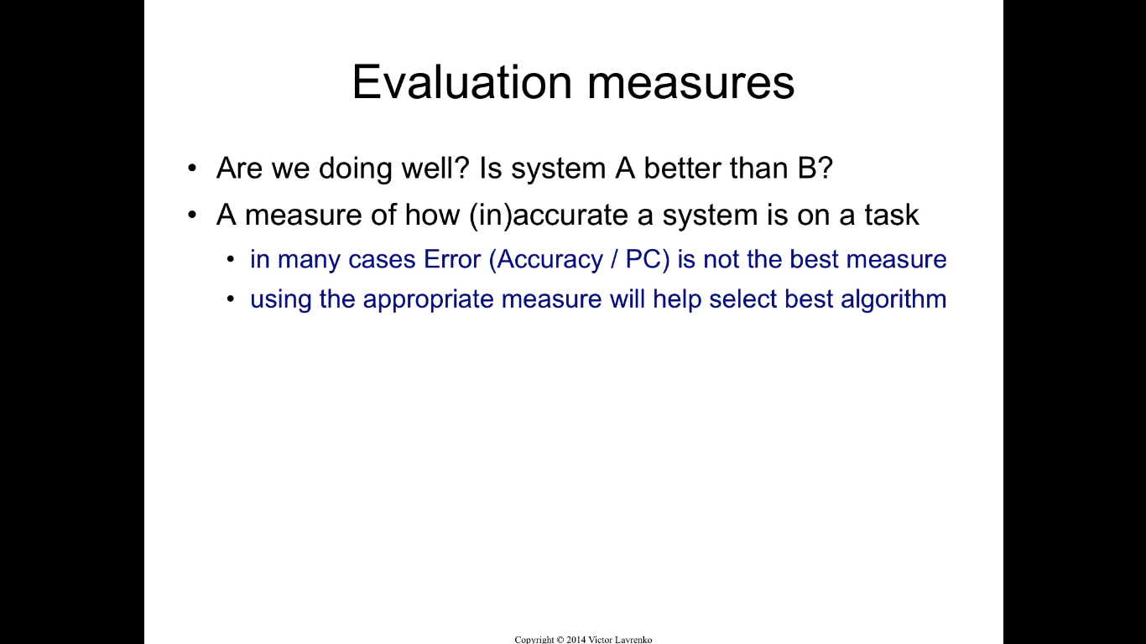

Slide 43
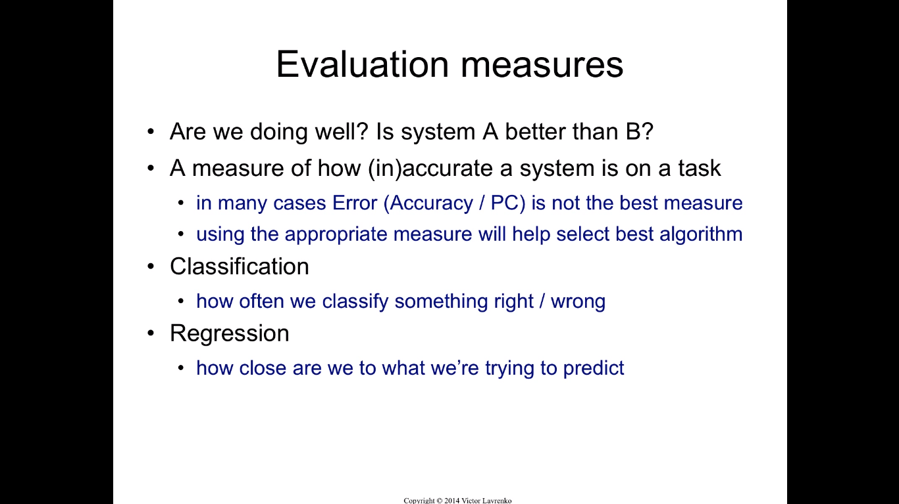

Slide 44
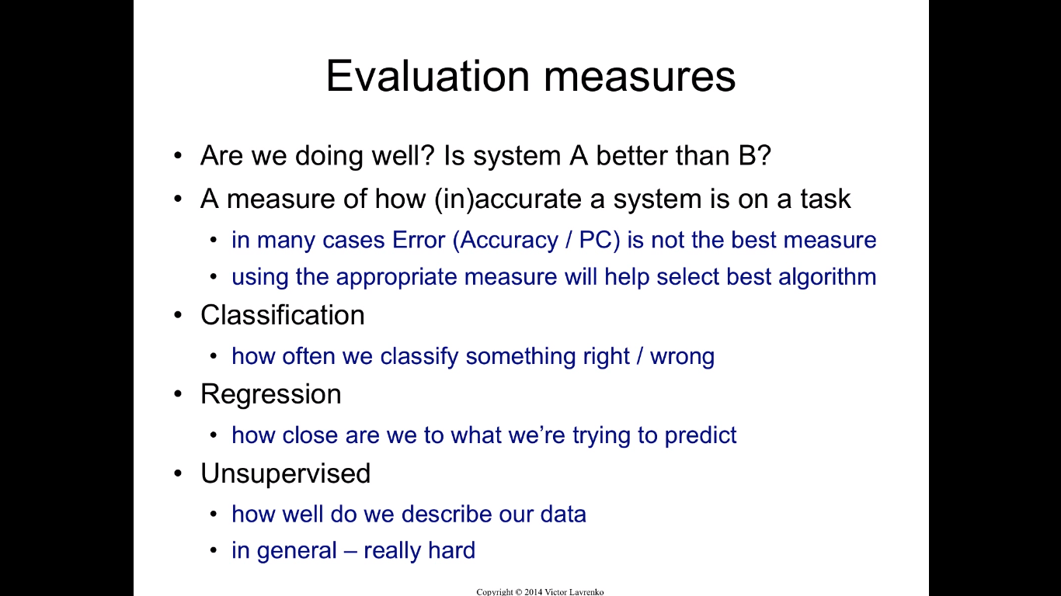

Slide 45
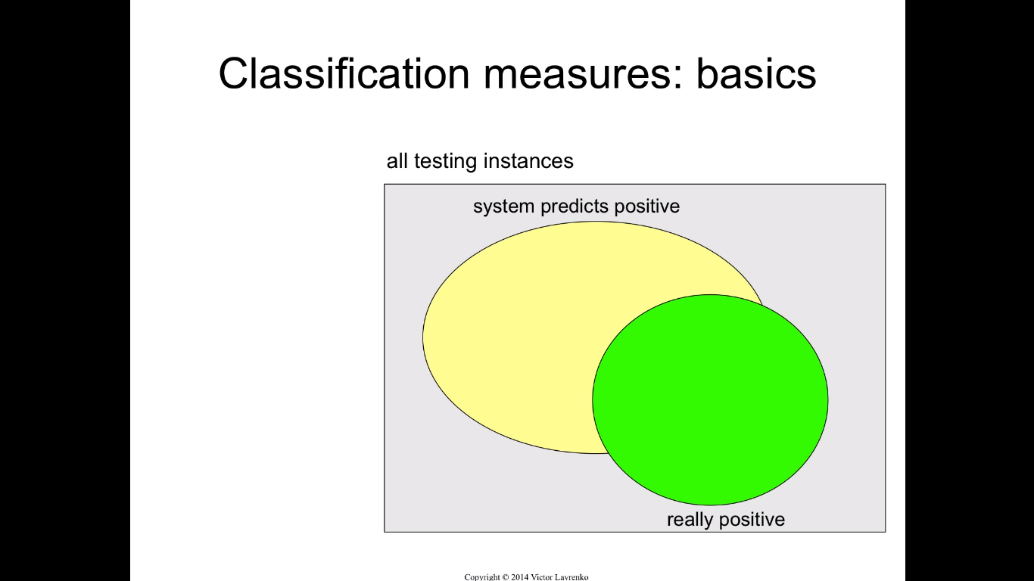

Slide 46
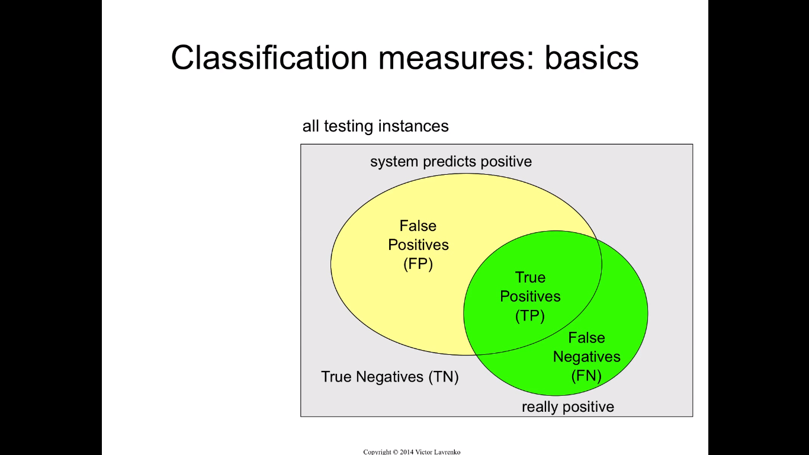

Slide 47
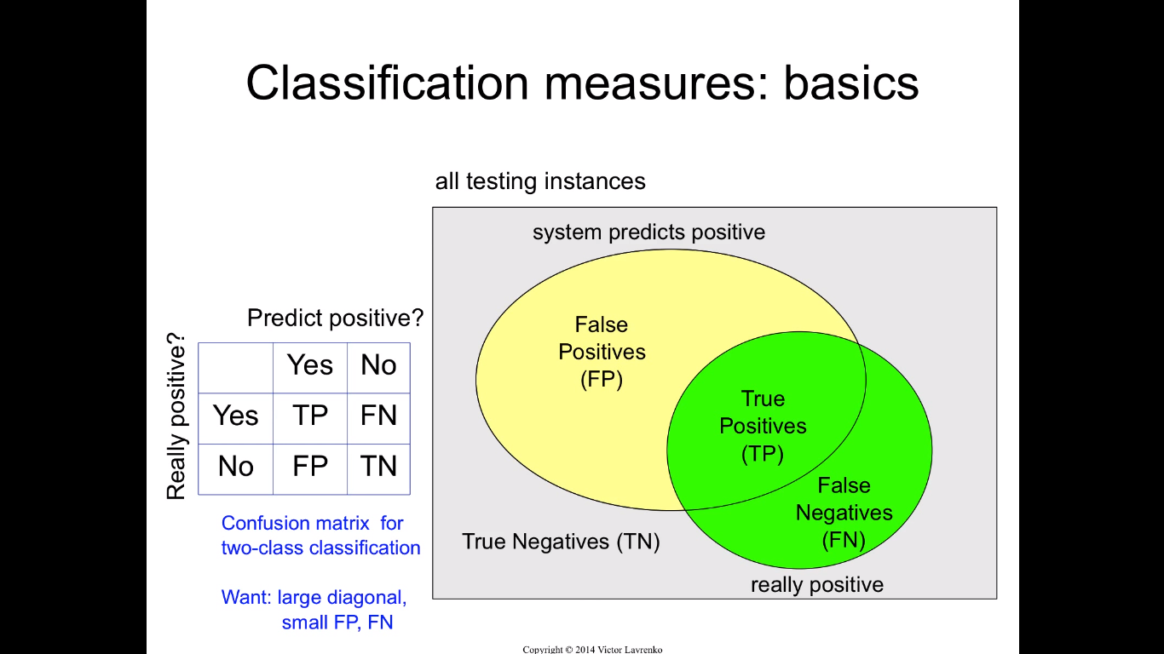

Slide 48
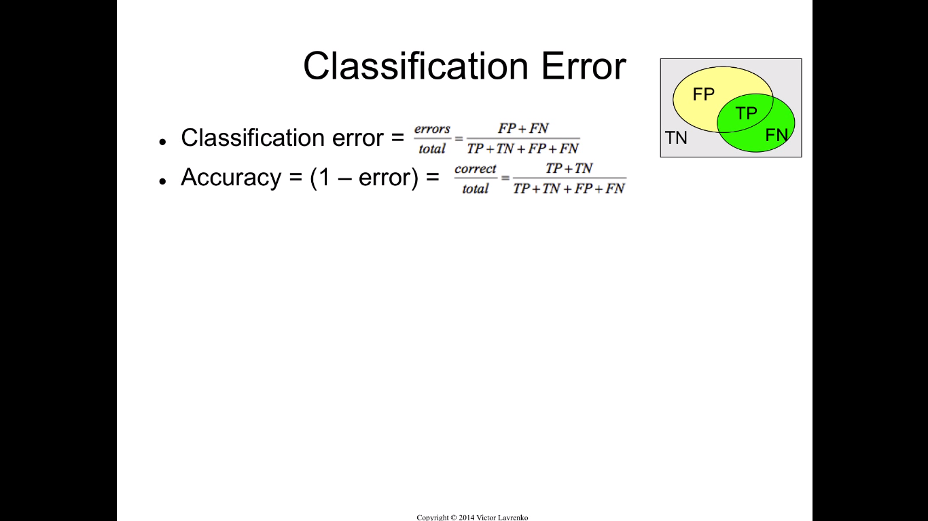

Slide 49
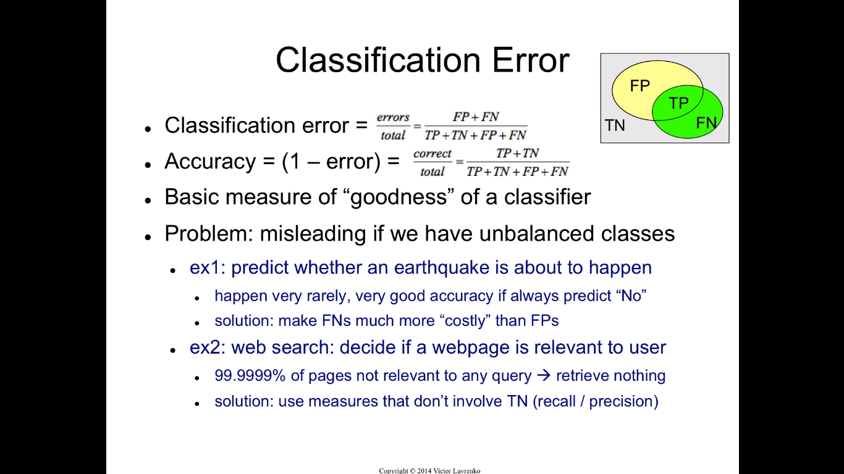

Slide 50
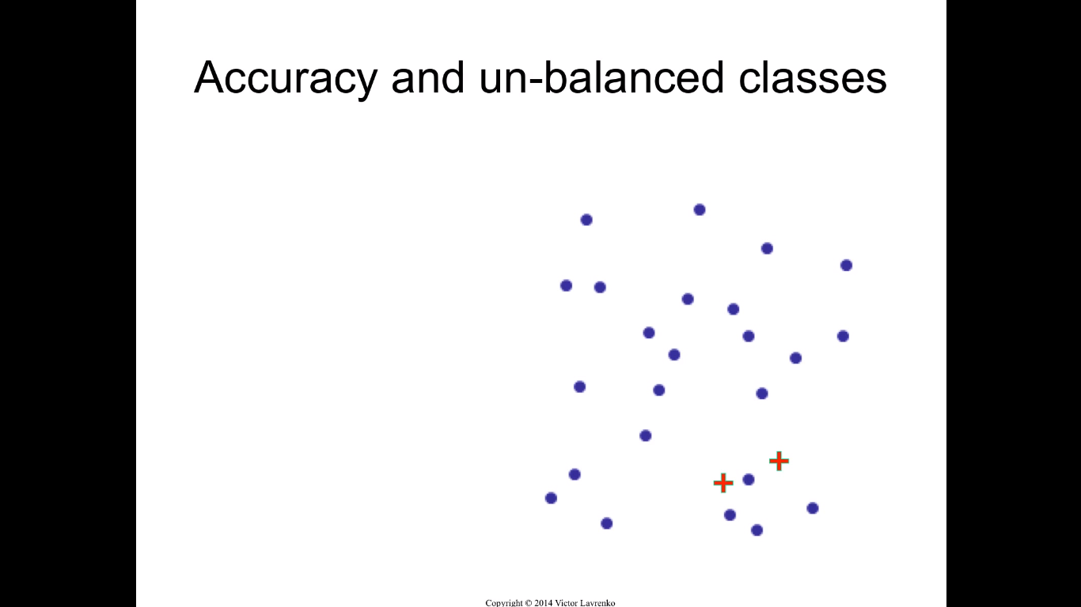

Slide 51
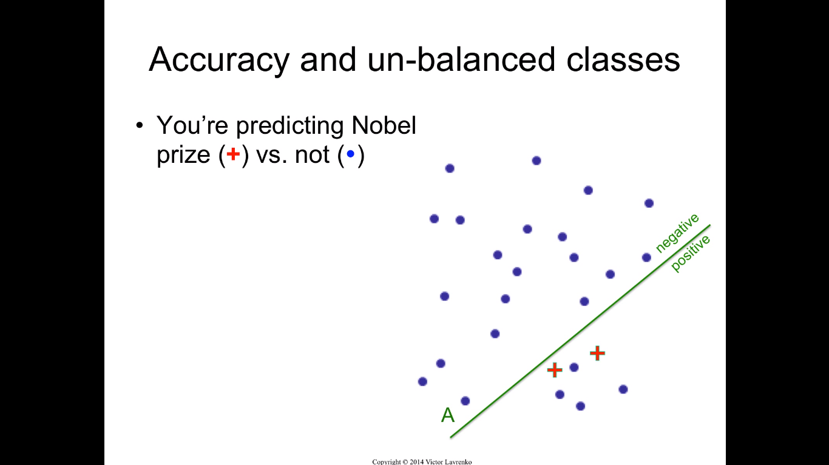

Slide 52
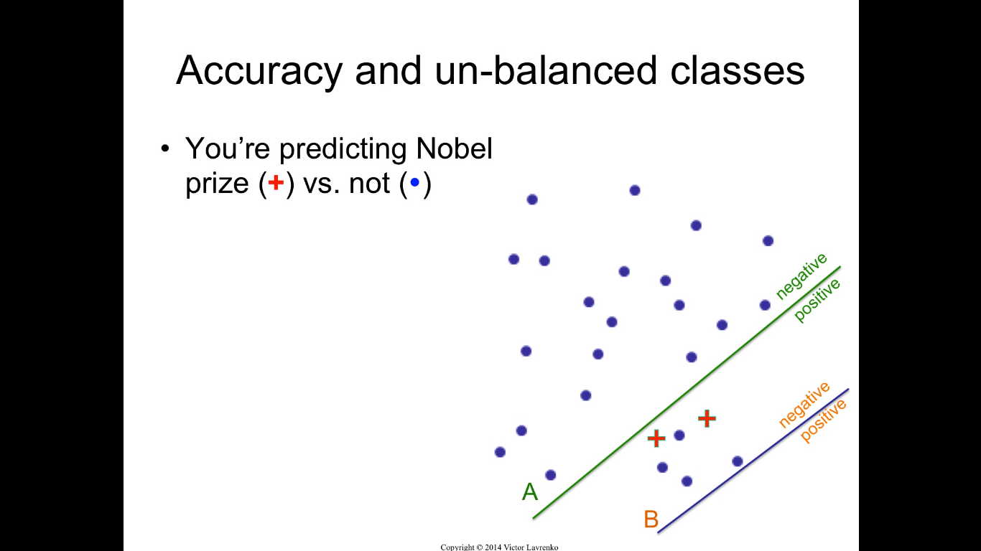

Slide 53


Slide 54


Slide 55


Slide 56




Recall for Cat is the number of correctly predicted Cat photos (4) out of the number of actual Cat photos (4+1+1=6), which is 4/6=66.7%. This means that our classifier classified 2/3 of the cat photos as Cat.
In a similar way, we can calculate the precision and recall for the other two classes: Fish and Hen. For Fish the numbers are 66.7% and 20.0% respectively. For Hen the number for both precision and recall is 66.7%. Go ahead and verify these results. You can use the two images below to help you.

Slide 57
Relative Entropy / Cross entropy intuition
The cross entropy has a very closed relation to relative entropy.
If we know a true distribution p, then we need H(p) bits on average to describe it, where H(p) is the entropy of p and is
H(p) = ∑p(x)logp(x).
But in some scenarios we want to know the distance(Kullback–Leibler distance) between two distributions say p and q. For instance to make it a metric of judging if a model is good enough in machine learning given the labels. Then here comes the relative entropy. Relative entropy is a measure of the inefficiency of assuming that the distribution is q when the true distribution is p. It is an expected logarithm of the likelihood

Slide 58
Cont’d
ratio:
D(p||q)=∑p(x)logp(x)/q(x)
=E(logp(X)/q(X)
D(p||q)= Cross Entropy
Cross Entropy= ∑p(x)logp(x)−∑p(x)logq(x)
=H(p)−∑p(x)logq(x)
Since H(p) is a constant then ”−∑p(x)logq(x)” (cross entropy here) is treated the same as the distance between the true distribution p and the observed distribution q.

Slide 59


Slide 60


Slide 61


Slide 62


Slide 63


Slide 64


